Slide 1

Kristen Barrett, Ben Graham, Joshua Do,
Patrick Mancuso, Matthew Wolff

Slide 2

What is Love Letter?
Love Letter is a strategy card game
Games are very brief
Quick Demo of Love Letter

Slide 3
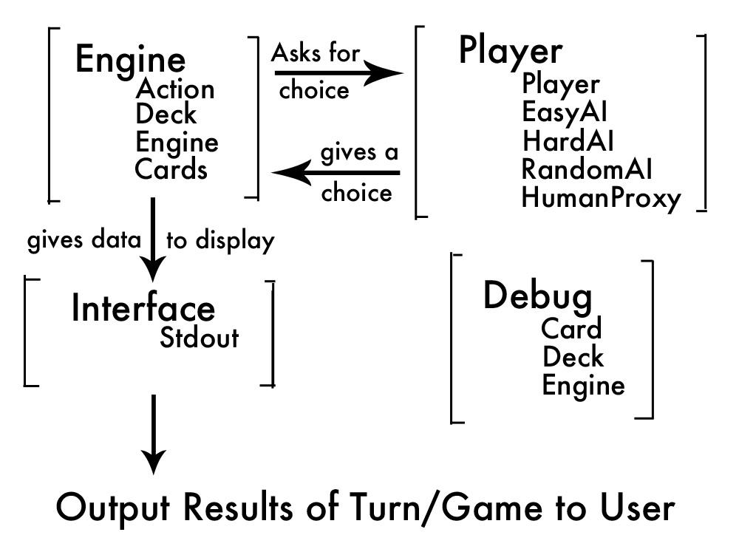
Structure Design & Implementation
Game Engine (environment)
Human Players (actor proxy)
Artificial Players (actors)
Random AI
Easy AI
Hard AI
Also has two play styles: aggressive and defensive

Slide 4
Engine Loop
Start Game Deal All Cards Discard One Deal a Card
Yes Get Action
>1 Players and more Do Action
cards in deck?
No Notify Players
Game Over

Slide 5
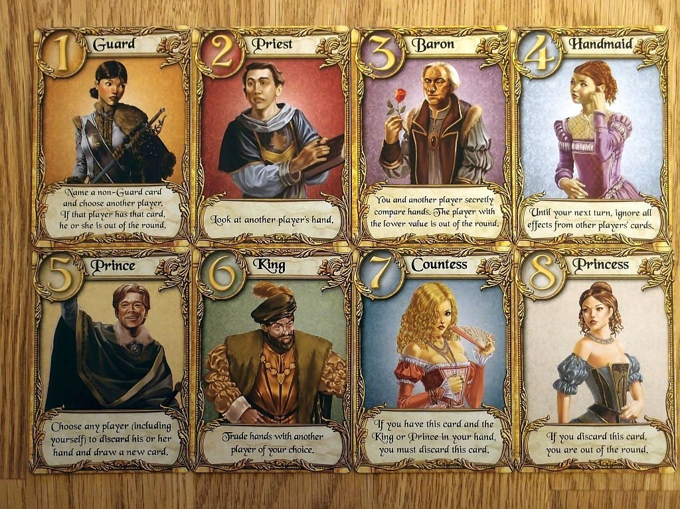
Structure Design and Implementation Cont.
You can play against the AI!
Abstractions allow for various human interfaces
Currently only works at the CLI, could be used with a GUI in the future
Could even be skinned for various “themes”
Easily modified for even network games
Player and Bot are the same type and are interchangeable
Original
Reskin

Slide 6
AI Implementation: Random
Always plays a random card
Targets a random player (except for Handmaid)
Chooses a random card type for Guard

Slide 7
AI Implementation: Easy
A Simple Reflex Agent that chooses whichever card has the lowest value.
Attempts to maximize its score by keeping the highest value it can get.

Slide 8
AI Implementation: Hard
AI keeps a live range of predictions of other players’ hands based on game actions and the graveyard state.
Prediction ranges are pruned through gameplay and by counting the cards left in the game
Actions are chosen based on the AI’s playstyle (Aggressive or Defensive) and the hand prediction ranges of other players.
Aggressive playstyle - Focused on eliminating other players quickly.
Defensive playstyle - Focused on maintaining the highest card in the game.

Slide 9
Experimentation Design
The levels of AI are designed to outperform each other
Random < Easy < Hard (< Human?)
Love Letter has a lot of random chance in it.
Luck of the draw has a large factor in performance
Random AI does not always lose to Hard AI
Love Letter also has elements of potential prediction
Counting cards (to an extent)
Knowledge of other players’ hands
Knowledge of what’s been played
Which AI has the highest win rate?

Slide 10
Live Demo!

Slide 11
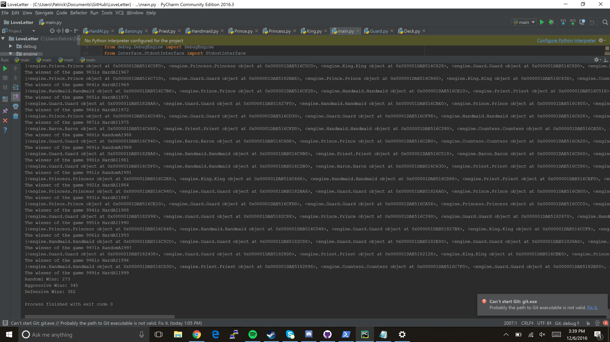
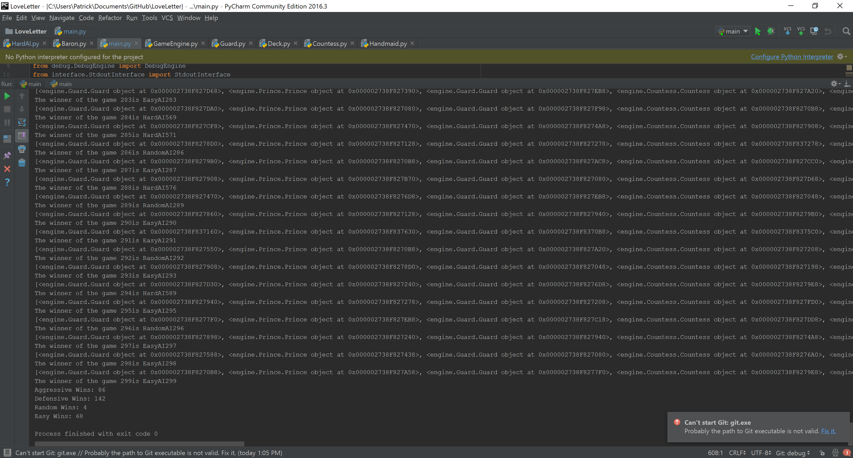
Experiment Results
300 games with Random AI, Hard (Aggressive), and Hard (Defensive)
Love Letter has a lot of random chance: DefensiveHard and AggressiveHard are pretty close
Playing intelligently and defensively seems best
Random is the worst however due to the heavy influence of chance in the game Random can win a reasonable number of games

